Slide 1
How to decode a PS2 Mouse
C2C Dustin Priaulx

Slide 2
Before you start…
Please go to this website and get yourself familiar with how a PS2 mouse (or keyboard) works:
Mouse: https://www.digikey.com/eewiki/pages/viewpage.action?pageId=70189075
Keyboard:
https://www.digikey.com/eewiki/pages/viewpage.action?pageId=28278929
** This tutorial will specifically cover how to decode a mouse***

Slide 3
Hardware needed
Breadboard
+5V/GND power
PS2 breakout chip
2x 1.1 kΩ resistors
Wires

Slide 4

Breadboard Schematic
Vcc +5V
Pin 6 (unused)
Vcc +5V
Pin 2 (unused)
PS2 Port Data (inout)
GND
CLK (inout)
1.1 kΩ
1.1 kΩ
FPGA
JA(1) (inout)
JA(0) (inout)
GND

Slide 5
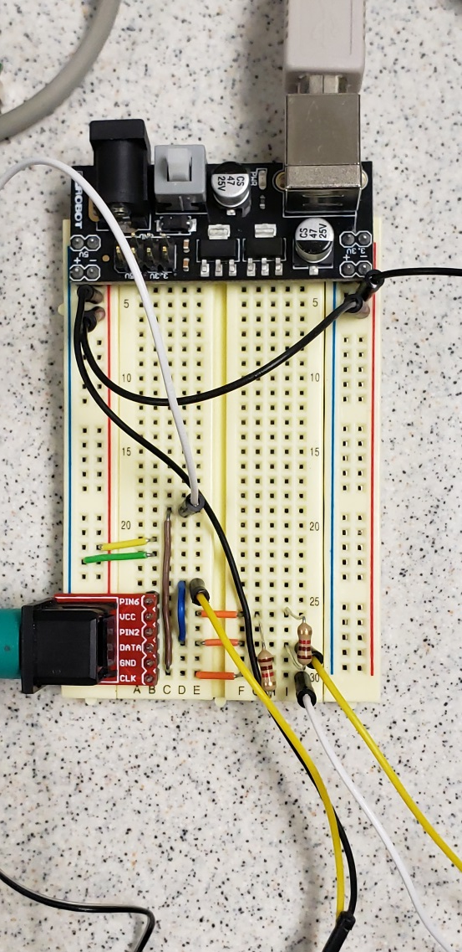
Actual Setup

Slide 6
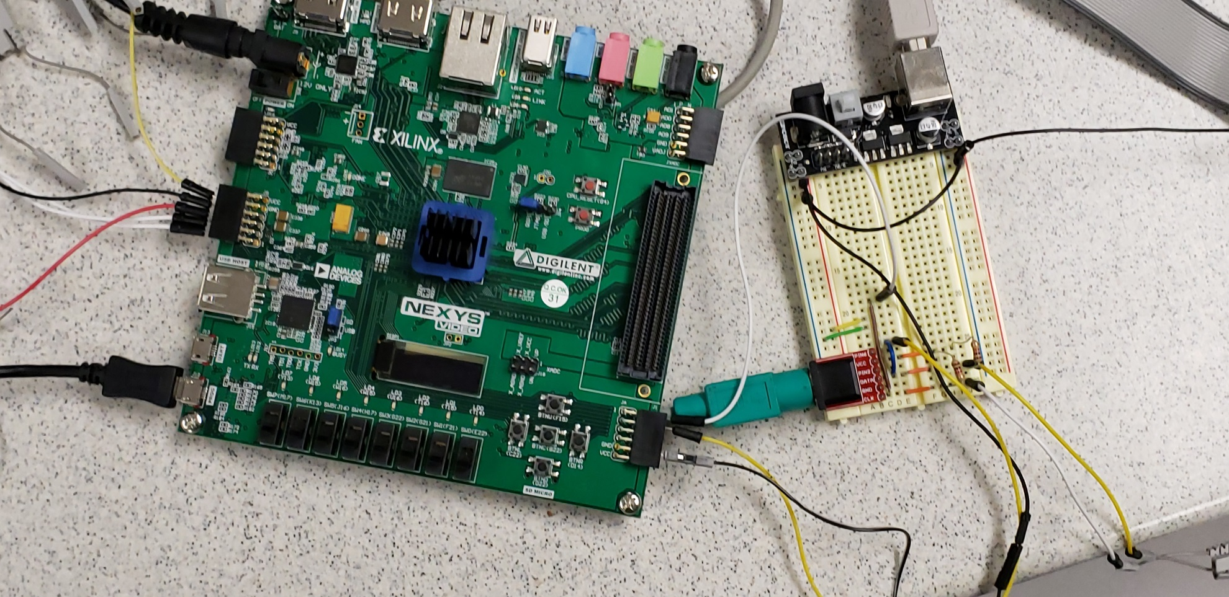
Bird’s Eye View

Slide 7
Software
Download the files that are in this .zip file:
ps2_mouse.vhd
ps2_transceiver.vhd
debounce.vhd
(also available on website on slide 2)

Slide 8
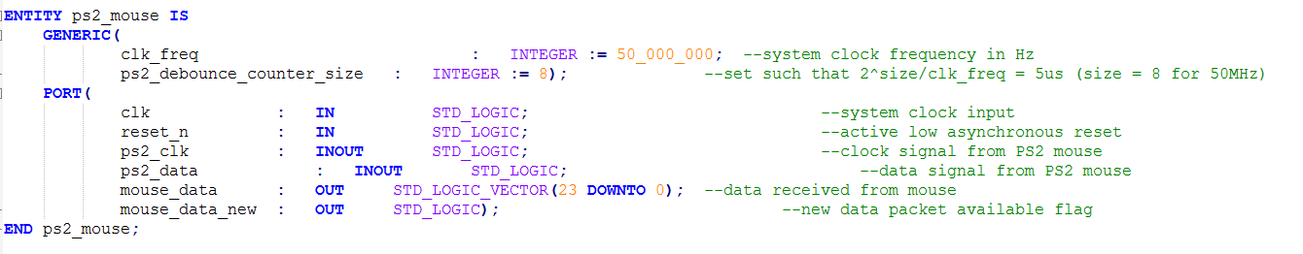
Tweak the Files
In ps2_mouse.vhd, change the generics
Clk_freq: 50_000_000 MHz => 100_000_000 MHz (Nexys Video7)
ps2_debouncer_counter_size: 8 => 9 (for 100MHz)

Slide 9
Understanding the inputs/outputs of the ps2_mouse.vhd code
clk: IN, system clock
reset_n : IN, active low asynchronous reset
ps2_clk: INOUT, clk signal from the ps2 mouse
ps2_data: INOUT, data signal from the ps2 mouse
mouse_data : OUT, data received from mouse
(already does bit shifting for you and gives it to you in a nice format w/o start/parity/stop bits)
mouse_data_new: new data packet available flag
Idle high, goes low when data starts to stream, goes back high when full packet of data (33 bits) is ready
*** File should already configure the mouse to go to streaming mode for you***

Slide 10
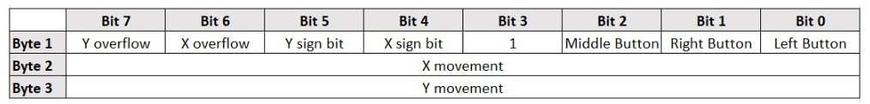
Interpreting mouse_data
Order: mouseData <= Byte1 7 downto 0 & Byte2 7 downto 0 & Byte3 7 downto 0

Slide 11
Interfacing with your Nexys Video 7
In your given .xdc, under “##HID port” there are two signals called ps2_clk and ps2_data. DO NOT UNCOMMENT THESE!!! Leave these two signal commented out.
Instead, under “## Pmod header JA” change ja[0] to ps2_clk and ja[1] to ps2_data.
In your top level file of your project, make these INOUT ports and then work them all the way down to the ps2_mouse.vhd file

Slide 12
Testing w/ Logic Analyzer (LA)
With your FPGA turned on and programmed, connect the ports on the Pods of the LA to the same nodes of the clk and data pins of the ps2 breakout board.
I connect Pod1[0] to clk and Pod0[1] to data.
I also send out mouse_data_new to the jb ports and also connect it to the logic analyzer at Pod2[0].
***Make sure your system (FPGA, BB, LA) all has a common GND!***

Slide 13
Testing w/ LA cont
Turn on and run application
It should take you to a flow chart looking workspace that more less looks like this:
In the left box, click the second to left icon.

Slide 14
Testing w/ LA cont
When you move the mouse, the ports that you hooked up should initially all be high
When you move the mouse, you should be seeing double sided arrows on show up.

Slide 15
Testing w/ LA cont
Click the “Sampling” Tab
Start sample rate at 100ns and Acquisition Depth to 4M.
Feel free to tinker with these values, but keep in mind that you do not want to sample too slowly.
Hit OK/Apply.

Slide 16
Testing w/ LA cont
Go to the “Waveform” Tab
Press “Run Single”
Move the mouse around/ click buttons
The waveform should show up with multiple triplets of data. Zoom in until you find one.

Slide 17
Testing w/ LA cont
Keep in mind this diagram; however, each byte also contains a ‘0’ start bit at the beginning and then 2 stop bits at the end (read documentation)
The LA shows each byte LSB first!!!
The following slides show you some things that you should be getting

Slide 18
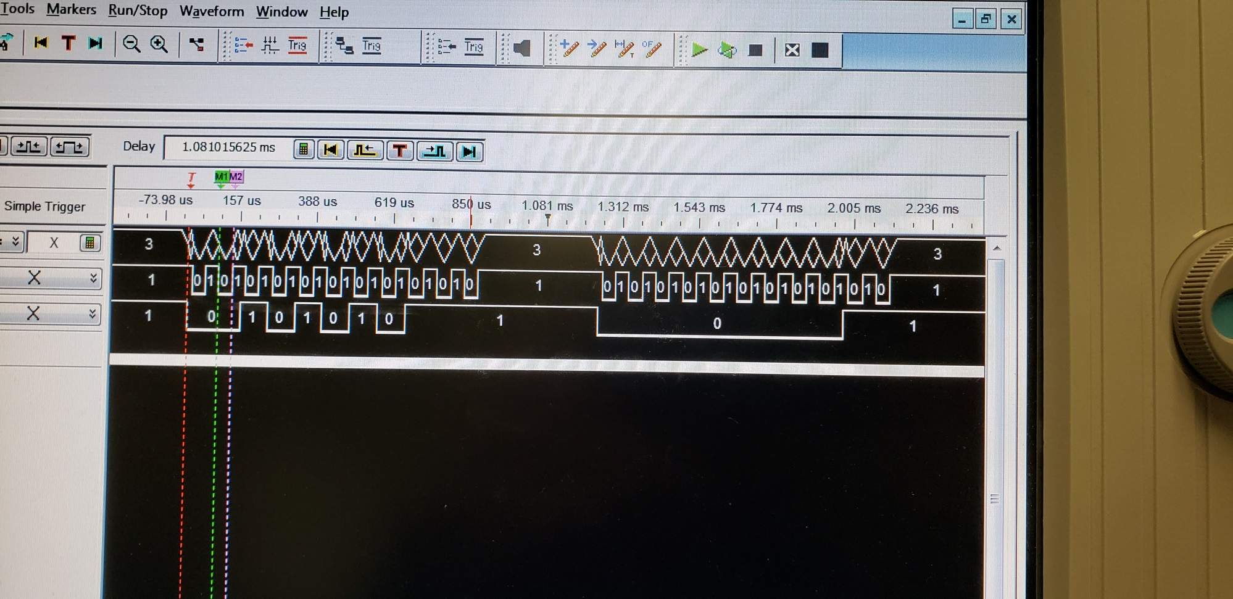
Signal you get when you give power to mouse mid-Run

Slide 19
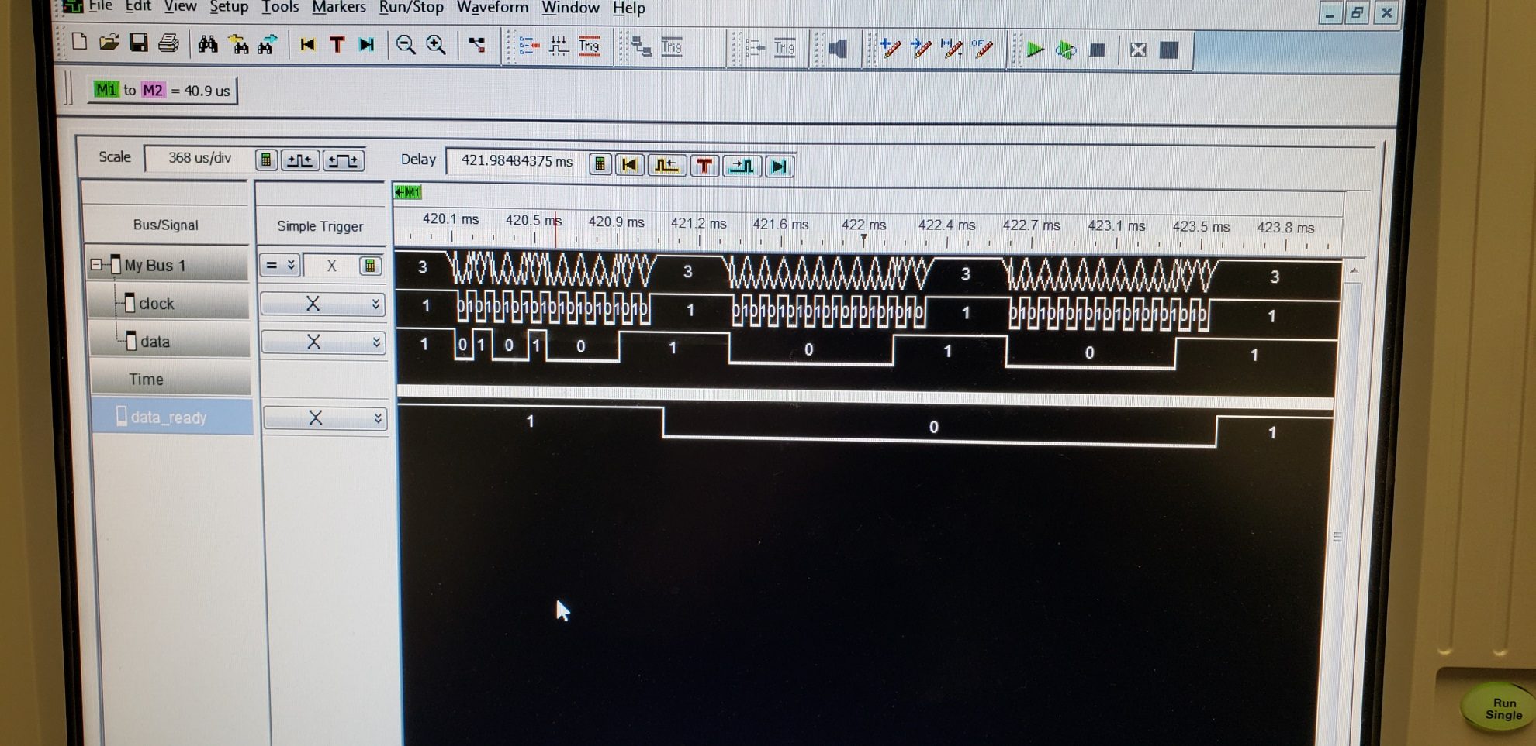
Left button clicked. Notice LB is bit 0 but shows up first. Same w/ X & Y movement

Slide 20
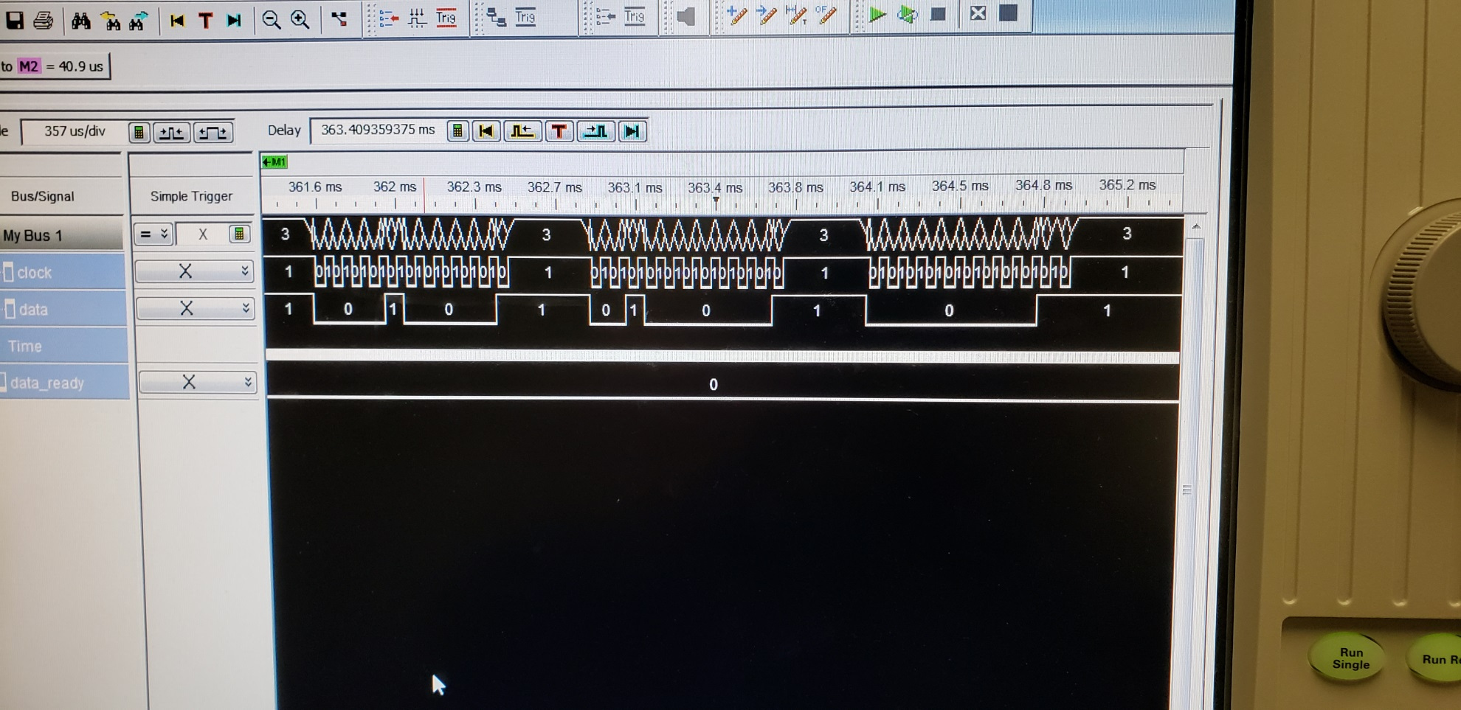
Strictly +x movement

Slide 21
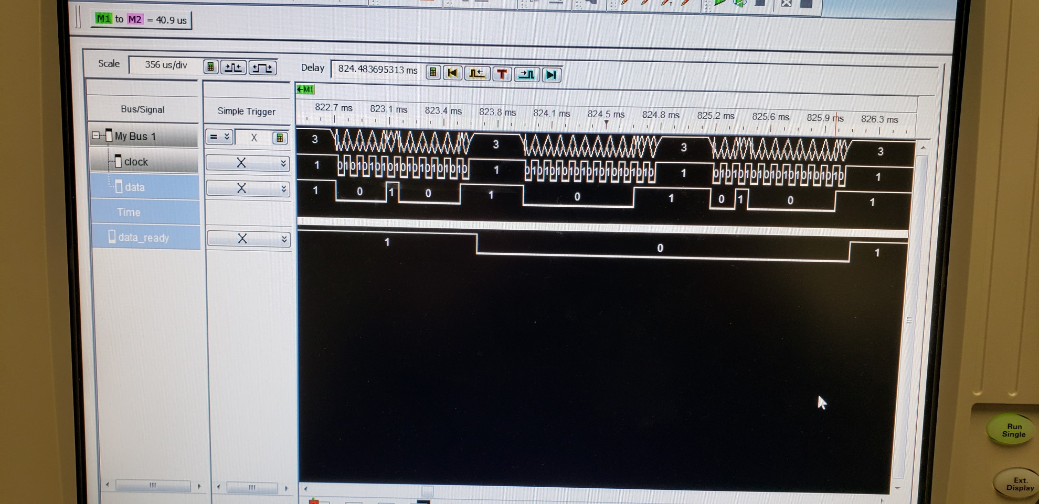
Strictly + y movement

Slide 22
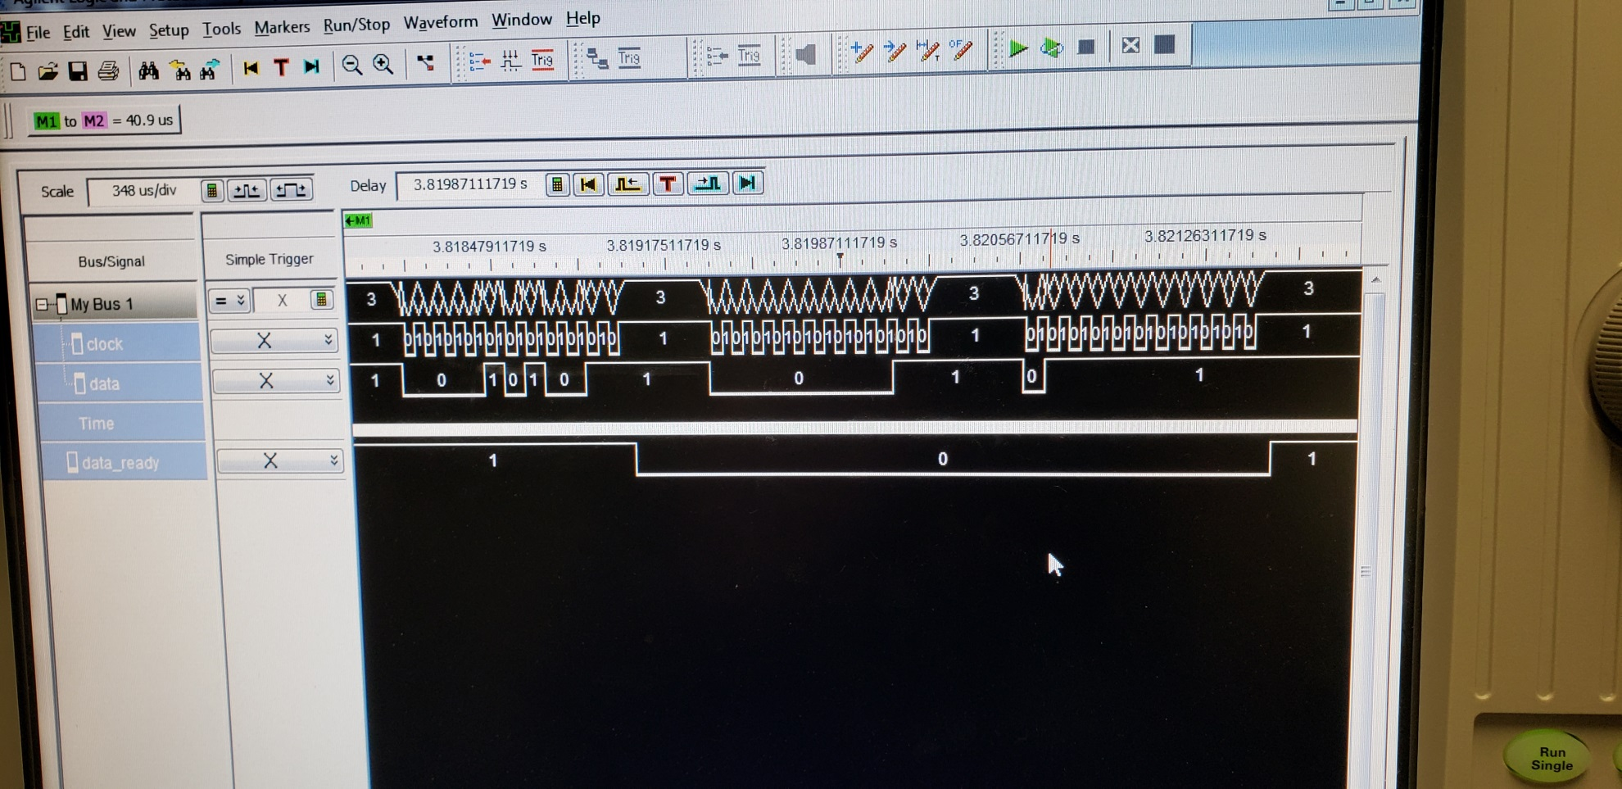
Movement in –y direction: YS high and Ymovement in 2’s complement

Slide 23
Next Steps
If you got this far, congrats! You most likely have your mouse working!
As far as next steps are concerned, I would create an FSM to latch your new data once your idle-high data_ready signal goes low, then high again. After that, I would create a couple of states to update the position of the mouse cursor that you have being drawn on the screen based on XS, YS, and X/Y movement.

Slide 24
Hope this helps!
- Former 383 Student

